Slide 2
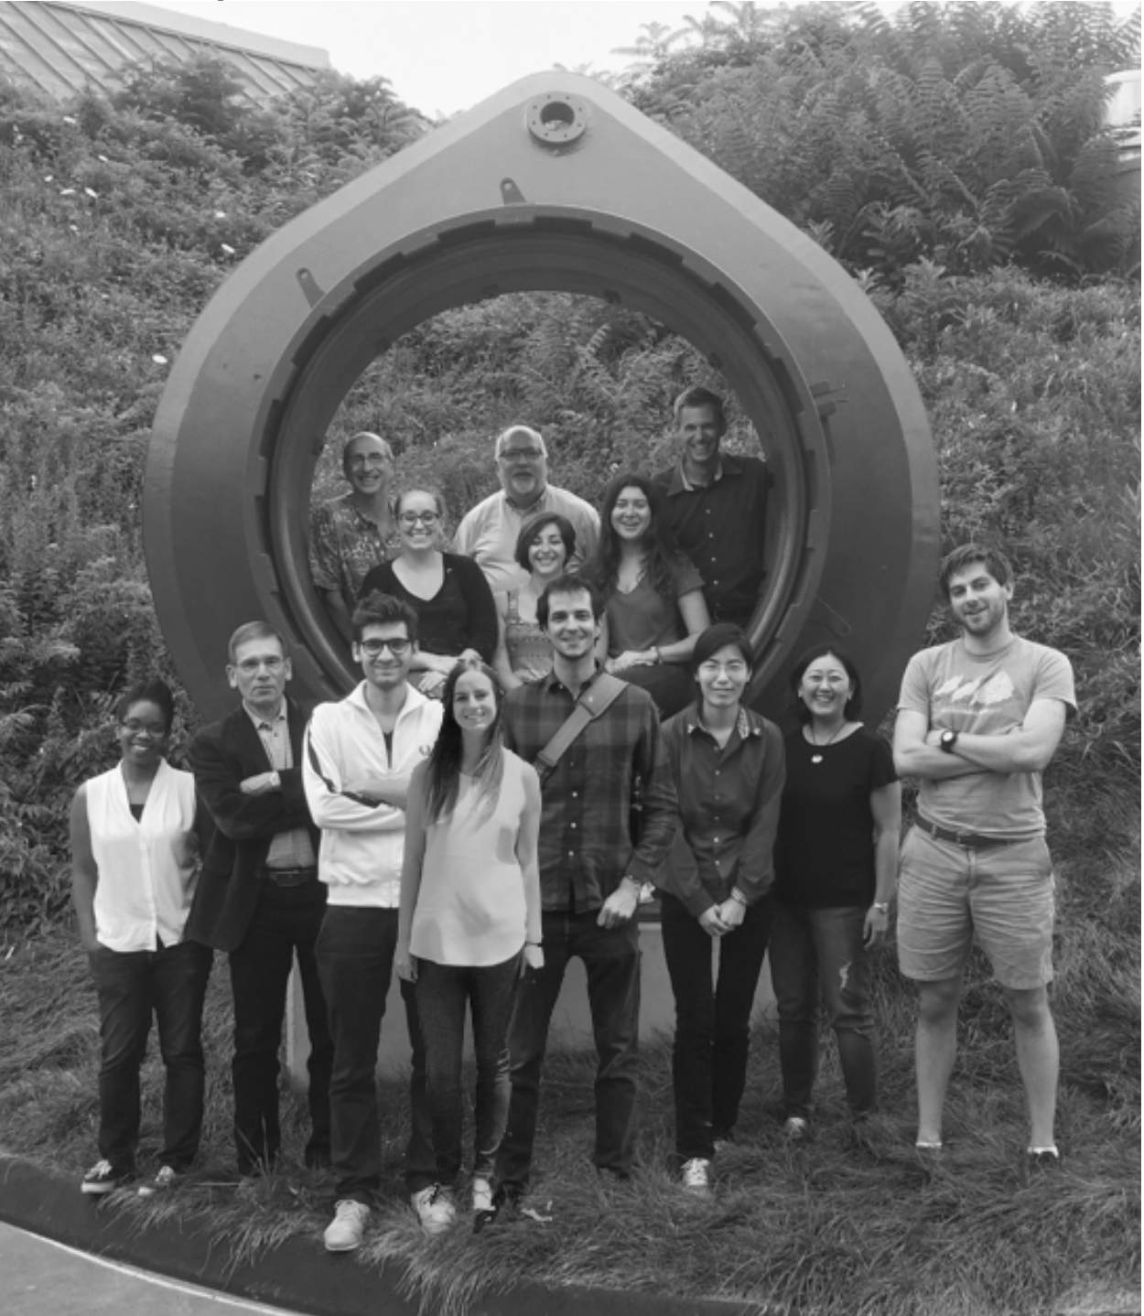

Slide 3
Axion detection: Yale, UC Berkeley, CU Boulder
Notes:
Bioengineering

Slide 4
Dark Matter Lab, Etcheverry Hall
Notes:
Bioengineering

Slide 5
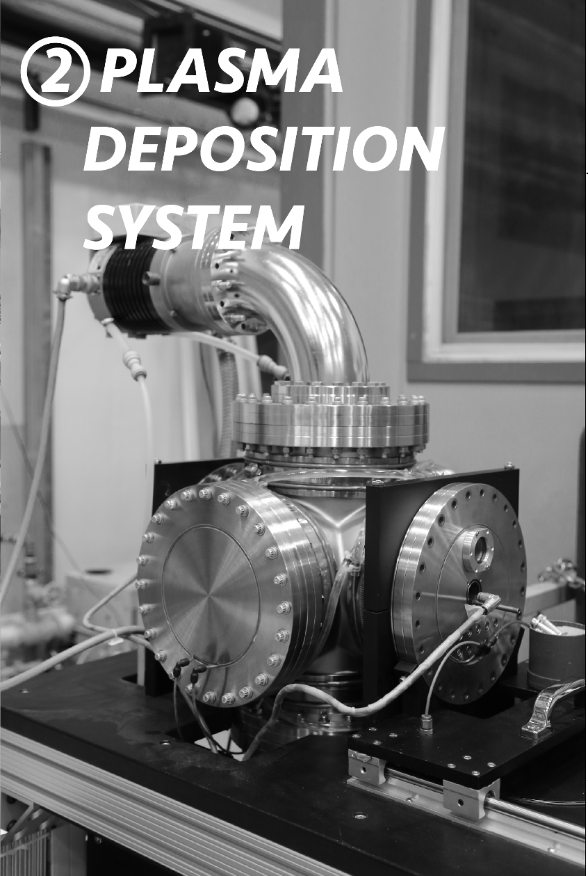
Notes:
Bioengineering

Slide 6
Notes:
Bioengineering

Slide 7
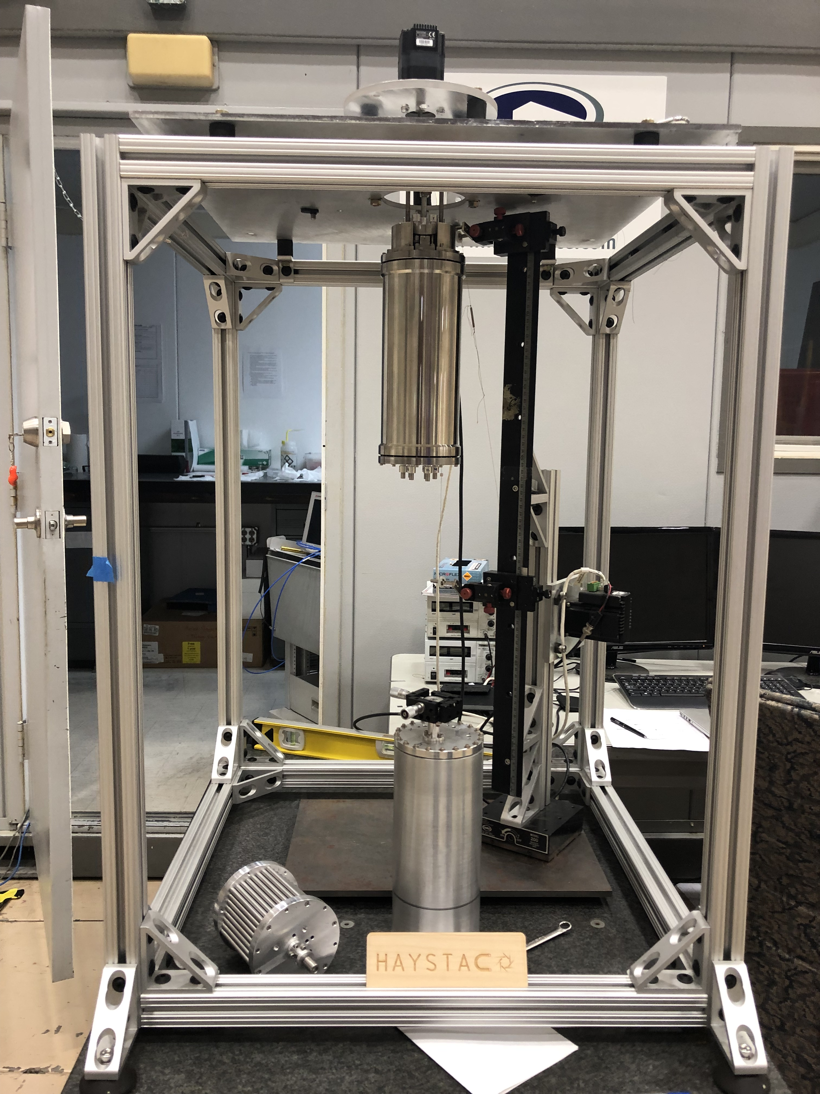
Axion Detector
Each piece of equipment has been modeled such that once inside in VR, the user will be able to experience the inner workings of these pieces of equipment at a high level of detail, down to individual screws as shown in this image.
Notes:
Bioengineering

Slide 8
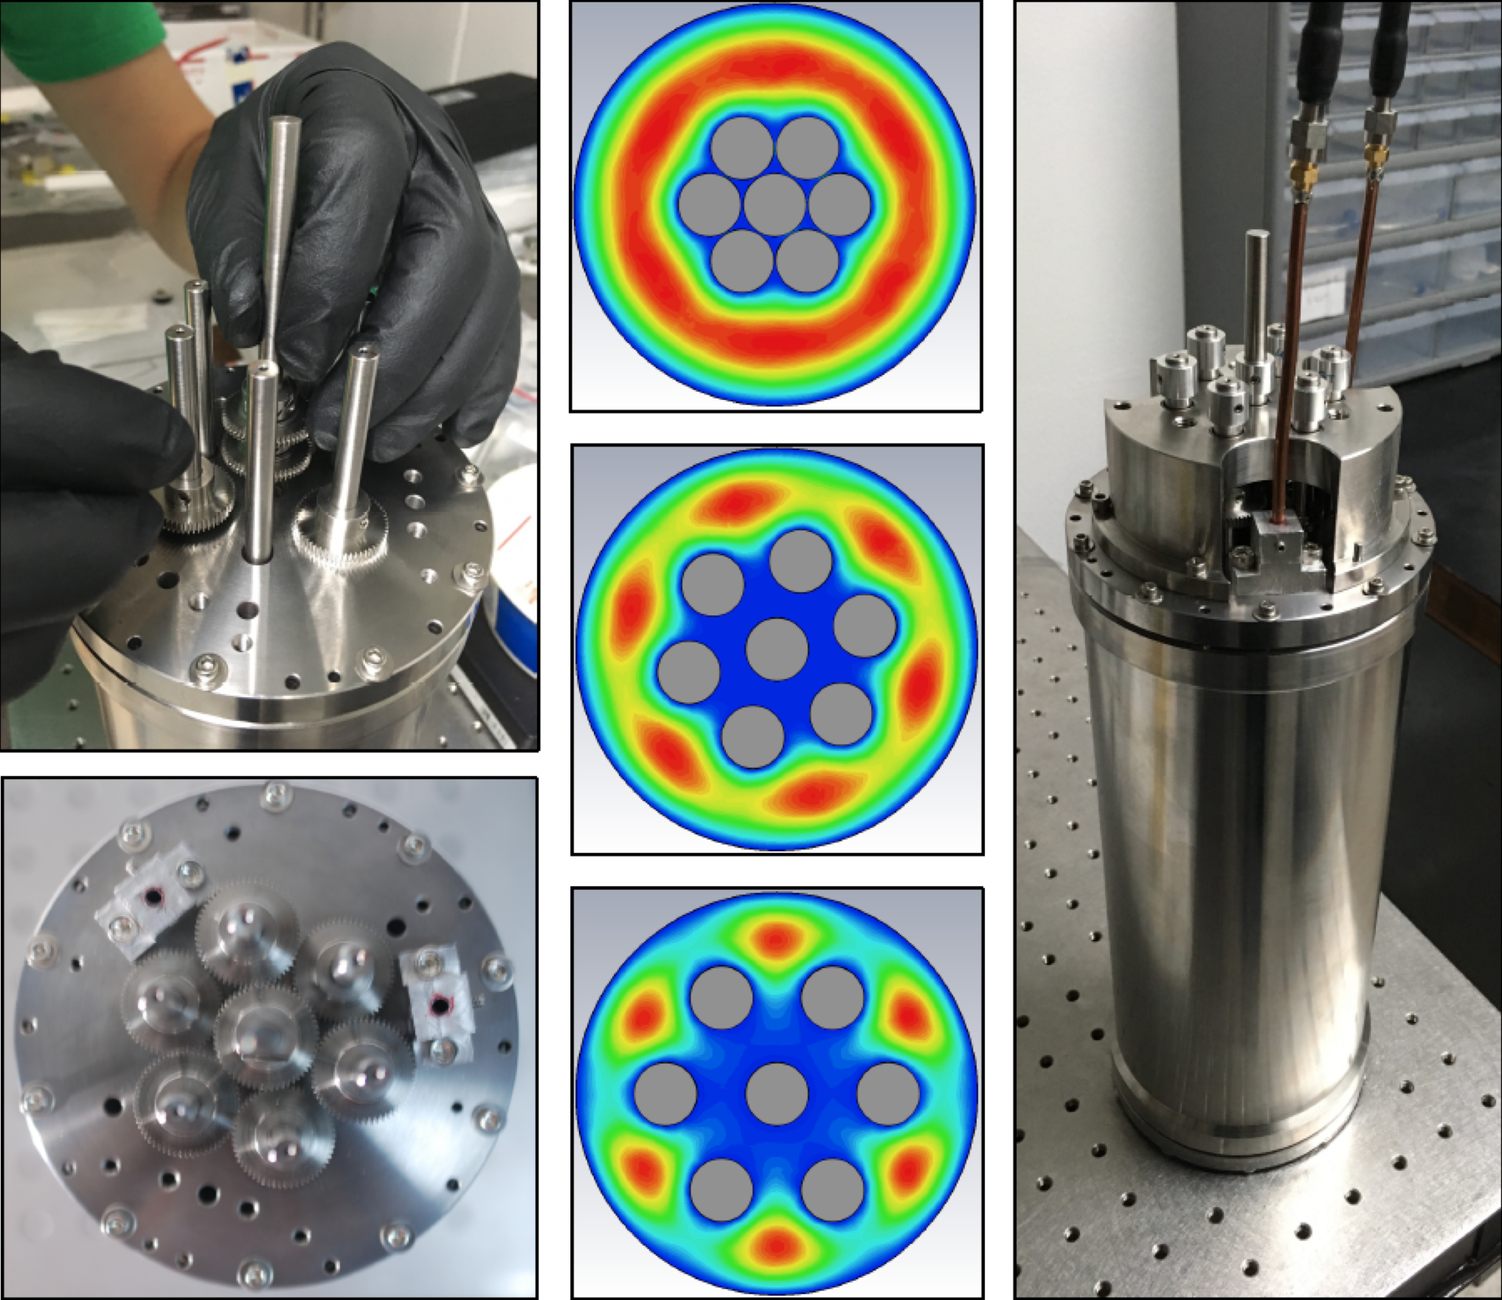
Cavity for Axion detection and experiment results
Notes:
Bioengineering

Slide 9
Dark Matter VR experience
1
2
3
The door is modeled directly from the entrance to the Dark Matter Lab, which operates in a space which once contained a nuclear reactor.
Through the door, the user discovers a long meandering ramp, which bring them through space down into the Dark Matter Lab. Various Illuminations draw them in.
The player begins at the beginning of a long dark corridor. A slightly door is ajar at the end.
Notes:
Bioengineering

Slide 10
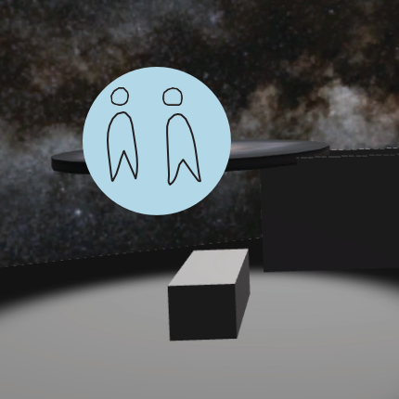
Dark Matter VR experience
4
5
6
At the center of the room, a large, primary sphere is your first stop in the lab. This sphere contains a 360 video which introduces the user to the concept of Dark Matter and its role in the universe.
Once in the lab, the user discovers 3 pieces of scientific equipment which they can interact with. Floating spheres are associated which each piece, which cues a 360 video explanation of the equipment function.
Some pieces of equipment can be scaled up so that the user may get inside them.
For example, users can visit the inside of the axion cavity detector, which in reality is less than 2 feet high.
Notes:
Bioengineering

Slide 11
